Slide 1
Wireless Technologies
Prepared By: Er. Amit kr. tewari
Associate Professor
CS Dept.
ACEIT, Jaipur

Slide 2
Wireless LAN
Wireless LANs are more commonly referred to by their trade name Wi-Fi.
Wi-Fi, WLAN, and 802.11 are the common names.
LANs within a company, government agency, hospital, or other organization typically use unshielded twisted pair as the transport medium.
However, more and more, wireless extensions to these LANs are becoming popular as are entirely wireless LANs.
Low-cost wireless modems installed in personal computers and laptops make this possible.

Slide 3
Wireless LANs Configurations
Three common configurations are used for Wireless LANs:
1. Wireless Access Point (AP) is connected to an existing wired LAN
2. AP is connected to the main LAN or more commonly to an Internet service provider (ISP)
3. Implementation of Home Networks

Slide 4
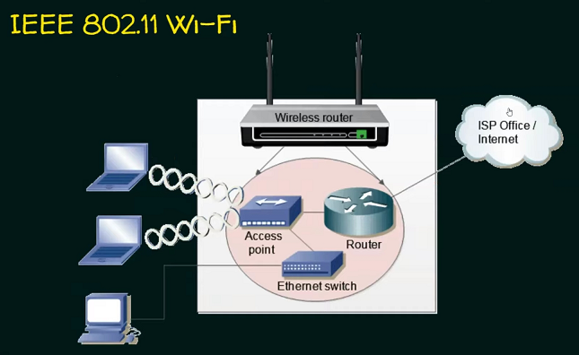

Slide 5
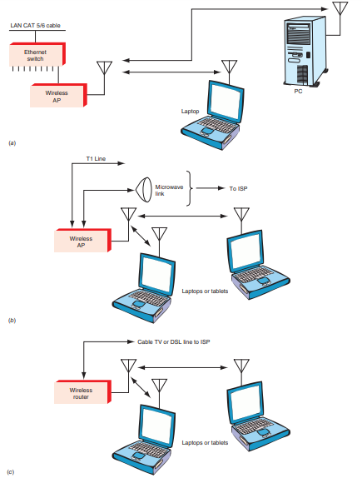

Slide 6
Hardware of Wireless LANs
The hardware devices in a wireless LAN are the access point or the gateway/router and the radio modems in the PCs.
The access point is just a box containing a transceiver that interfaces to an existing LAN by way of CAT5/6 wiring.
It typically gets its dc operating power via the twisted-pair cabling.
The IEEE 802.3af standard related to furnishing dc power over the network cable is referred to as Power over Ethernet (PoE).

Slide 7
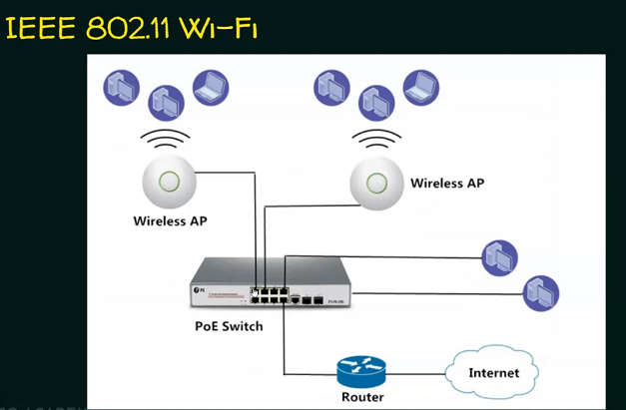

Slide 8
Hardware of Wireless LANs
The AP is usually mounted high on a wall or ceiling to give good coverage to a specific area.
The antenna may be built into the box or may be a separate array that gives directionality to the AP to ensure coverage of a desired area and minimum interference to other nearby WLANs.

Slide 9
Wireless LAN Standards
Over the years, a number of wireless LAN methods have been developed, tested, and abandoned. One standard has emerged as the most flexible, affordable, and reliable.
Known as the IEEE 802.11 standard, it is available in multiple forms for different needs. The table shows the different versions of the standard and some technical details.

Slide 10
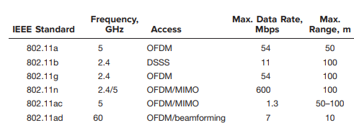
Wireless LAN Standards

Slide 11
IEEE 802.11 Architecture
The components of an IEEE 802.11 architecture are as follows:
Stations (STA)
Basic Service Set (BSS)
Extended Service Set (ESS)
Distribution System (DS)

Slide 12
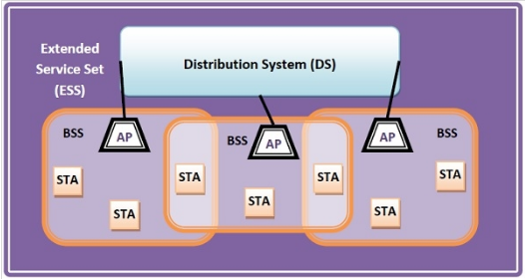

Slide 13
Stations (STA)
Stations comprises of all devices and equipment that are connected to the wireless LAN. A station can be of two types−
Wireless Access Point (WAP) − WAPs or simply access points (AP) are generally wireless routers that form the base stations or access.
Client- Clients are workstations, computers, laptops, printers, smartphones, etc.

Slide 14
Basic Service Set (BSS)
A basic service set is a group of stations communicating at the physical layer level. BSS can be of two categories depending upon the mode of operation−
Infrastructure BSS − Here, the devices communicate with other devices through access points.
Independent BSS − Here, the devices communicate in a peer-to-peer basis in an ad hoc manner.

Slide 15
Extended Service Set (ESS)
It is a set of all connected BSS

Slide 16
Distribution System (DS)
It connects access points in ESS.

Slide 17
PANs and Bluetooth
A personal-area network (PAN) is a very small wireless network that is created informally or on an ad hoc basis.
It typically involves only two or three nodes, but some systems permit many nodes to be connected in a small area.
The most popular wireless PAN system is Bluetooth, a standard developed by the cell phone company Ericsson for use as a cable replacement.
The objective was to provide hands-free cell phone operation by eliminating the cable connecting a cell phone to a headset.

Slide 18
Bluetooth
Bluetooth is a digital radio standard that uses frequency-hopping spread spectrum (FHSS) in the unlicensed 2.4-GHz ISM band.
It hops over 79 frequencies spaced 1 MHz apart from 2.402 to 2.480 GHz.
The hop rate is 1600 hops per second. The dwell time on each frequency, therefore, is 1/1600 = 625 µs.

Slide 19
Bluetooth
During this time, digital data is transmitted. The total data rate is 1 Mbps, but some of that is overhead (headers, error detection and correction, etc.)
The actual data rate is 723.2 kbps simplex or 433.9 kbps duplex.
The data, which may be voice or any other digitized information, is put into packets and transmitted sequentially in as many as five time slots.
The serial data signal is Gaussian-filtered, and then FSK is used for modulation.

Slide 20
Bluetooth
Three levels of transmission power have been defined, depending upon the application. For short distances up to 10 m, class 3 power at 0 dBm (1 mW) is used.
For longer distances or more robust operation in an environment with obstacles and noise, the higher-power class 2 can be used with 4 dBm or 2.5 mW.
Maximum Bluetooth range is about 100 m and is achieved with class 1 power of 20 dBm or 100 mW

Slide 21
Bluetooth
Bluetooth transceivers are available as single-chip transceivers that interface to the device to be part of a PAN.
These devices invariably contain some kind of embedded controller that handles the application. If voice is used, a vocoder is needed.

Slide 22
Bluetooth Establishment
Bluetooth is set up so that the wireless transceiver constantly sends out a search signal and then listens for other nearby, similarly equipped Bluetooth devices.
If another device comes into range, the two Bluetooth devices automatically interconnect and exchange data.
These devices form what is called a piconet, the linking of one Bluetooth device that serves as a master controller to up to seven other Bluetooth slave devices.
Once the PAN has been established, the nodes can exchange information with one another. Bluetooth devices can also link to other piconets to establish larger scatternets.

Slide 23
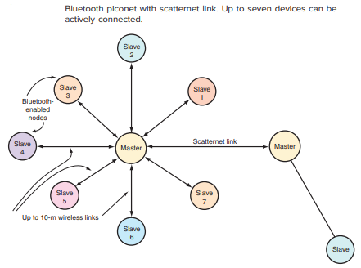

Slide 24
Bluetooth version 2.0
Another version 2.0 of Bluetooth is called Enhanced Data Rate (EDR). It has all the features described earlier but increases the overall data rate to 3 Mbps.
The 3-Mbps rate includes all the headers and other overhead. The raw data rate is three times the 723 kbps rate mentioned earlier for a net rate of more than 2.1 Mbps.
The new protocol still transmits at 1 Mbps using GFSK for accessing and recognizing inputs to establish a link.

